Slide 1
Seminar DA150X
Jane Bottomley

Slide 2
Timetable (31 March, 3 April)
13.00-13.15 Welcome
13.15-13.30 Peer review guidelines
13.30-13.45 Look at your own text with your writing partner and make notes
13.45-14.15 Read the text of another pair and make notes
14.15-15.00 Peer review of introductions
15.00-15.15 Break
15.15-15.30 Language and flow review
15.30-15.50 Peer review of language and flow
15.50-16.00 Q & A

Slide 3
Where do we start?
Audience
Purpose
Strategy

Slide 4
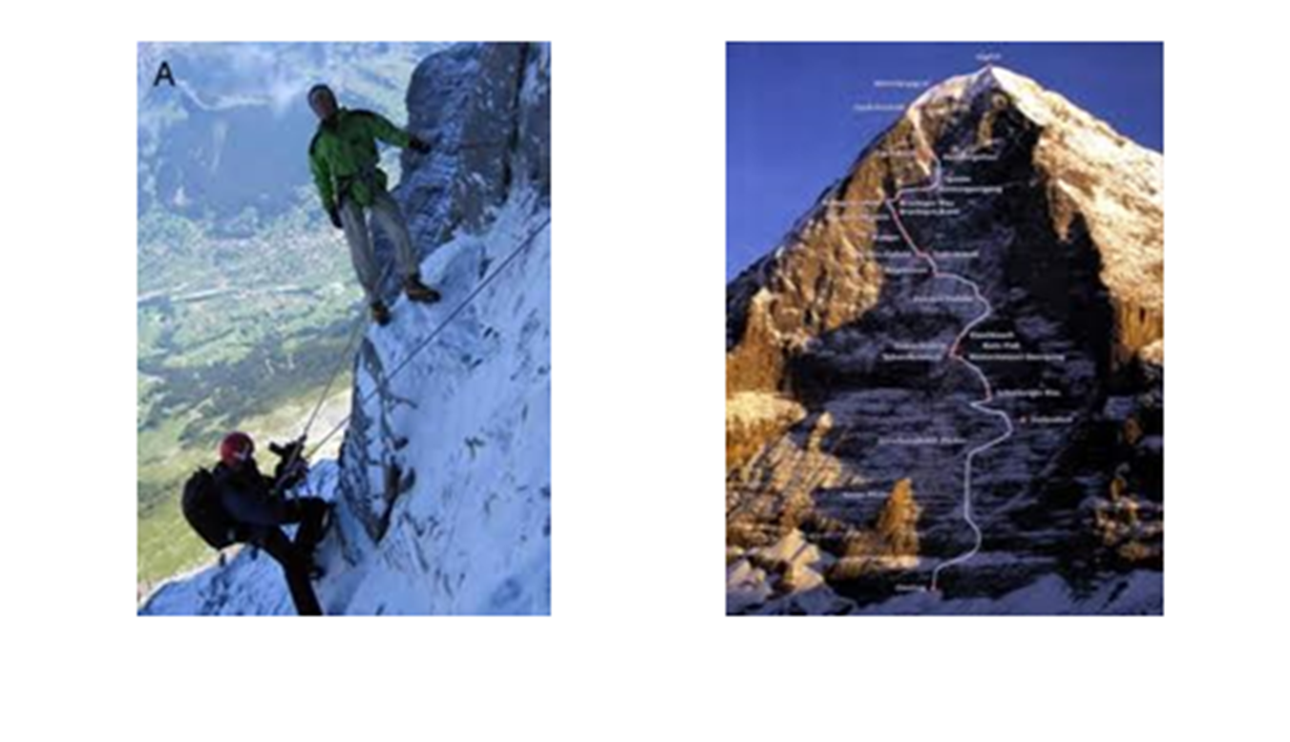
Peer review: Approach
A peer reviewer is a reader and a critical friend
You will see the text through their eyes
You can put yourself in the reader’s shoes
Stand back from your text
Get some distance

Slide 5
Peer review: Reviewing introductions
Does the introduction attract the reader’s attention?
Is there a clear link between the problem and why this study was carried out?
Is the research question clearly stated?
Are the aims and objectives clearly stated?
Is the text reader-friendly?

Slide 6
Peer review: Process
Start by deciding how to divide up the time so that you spend the same time on each text
Keep an eye on the time
Be constructive in your feedback
It should be a dialogue – let the authors respond to your points

Slide 7
Peer review: Responding to feedback
Which advice will you accept? Why?
Which advice will you reject? Why?
Which advice will you reserve judgement on? Why?

Slide 9
Peer review: Language and flow
Before the next part of the peer review, we will review some aspects of language and flow by analysing parts of a KTH research project introduction

Slide 10
Example paragraphs from Introduction section of:
Effects of Different Worker Heuristics in Marriage in Honey Bees Optimization: As Applied to the Graph Coloring Problem
Li, Lisa, KTH, School of Electrical Engineering and Computer Science (EECS)
Vyth, Jakob, KTH, School of Electrical Engineering and Computer Science (EECS).
2018 (English)
https://www.kth.se/social/course/DD142X/page/good-report-examples/

Slide 11
Example paragraphs
Generally clear and well written
Demonstrates features of good flow
Good but not perfect
Note what is good but think about what could be improved

Slide 12
How is this paragraph structured? What do the different colours represent?
Biologically inspired algorithms are based on the observed and interpreted behaviors in biological systems. Examples include a wide variety of systems, one of which is honey bees. Honey bee colonies consist of tens of thousands individual bees working together in a highly structured social order toward a common goal - the survival of the colony. There are several different kinds of tasks within the colony that need to be completed in an optimized manner. Studying these optimization behavioral patterns can produce interesting meta-heuristics for solving difficult computational problems.

Slide 13
Topic sentence
Examples
Biologically inspired algorithms are based on the observed and interpreted behaviors in biological systems. Examples include a wide variety of systems, one of which is honey bees. Honey bee colonies consist of tens of thousands individual bees working together in a highly structured social order toward a common goal - the survival of the colony. There are several different kinds of tasks within the colony that need to be completed in an optimized manner. Studying these optimization behavioral patterns can produce interesting meta-heuristics for solving difficult computational problems.
Important details
Refers back and summarises before adding new and important information

Slide 14
What is the purpose of the highlighted phrases? What is the purpose of the second sentence?
A behavioral pattern that has lead to intensive research is the mating process of honey bees. The mating process involves all different kinds of bees in the colony: the fertile female bees called queens, the male bees called drones, and infertile female bees called worker bees. The mating process begins when a queen initiates a so called mating flight. During the mating flight, the queen mates with several drones in succession and uses their sperm to lay eggs. The eggs are raised into broods by the worker bees. Female broods become queens depending on how they are raised, and the mating process begins anew with the new queens.

Slide 15
Repetition of main theme + clear verbs throughout paragraph developes theme step by step
A behavioral pattern that has lead to intensive research is the mating process of honey bees. The mating process involves all different kinds of bees in the colony: the fertile female bees called queens, the male bees called drones, and infertile female bees called worker bees. The mating process begins when a queen initiates a so called mating flight. During the mating flight, the queen mates with several drones in succession and uses their sperm to lay eggs. The eggs are raised into broods by the worker bees. Female broods become queens depending on how they are raised, and the mating process begins anew with the new queens.

Slide 16
Clear categorisation using colon
A behavioral pattern that has lead to intensive research is the mating process of honey bees. The mating process involves all different kinds of bees in the colony: the fertile female bees called queens, the male bees called drones, and infertile female bees called worker bees. The mating process begins when a queen initiates a so called mating flight. During the mating flight, the queen mates with several drones in succession and uses their sperm to lay eggs. The eggs are raised into broods by the worker bees. Female broods become queens depending on how they are raised, and the mating process begins anew with the new queens.

Slide 17
What is the function of the highlighted words? How does the use of acronyms aid flow?
MBO has been shown to be applicable on several different problems, among them the Graph Coloring Problem (GCP). The goal of GCP is to assign colors to the vertices of a graph such that no neighbor vertices have the same color using a minimal amount of colors. GCP is applicable to many real life applications such as taxi scheduling, timetable construction, and compiler register allocation (Lewis, 2016). Unfortunately, GCP is NP-complete (Karp, 1972), meaning there is no known efficient (polynomial-time) algorithm for finding a coloring which uses the minimal amount of colors for any given graph. Therefore, finding polynomial-time heuristics for solving GCP is of interest.

Slide 18
First part of text lays the ground for introduction of problem and solution
MBO has been shown to be applicable on several different problems, among them the Graph Coloring Problem (GCP). The goal of GCP is to assign colors to the vertices of a graph such that no neighbor vertices have the same color using a minimal amount of colors. GCP is applicable to many real life applications such as taxi scheduling, timetable construction, and compiler register allocation (Lewis, 2016). Unfortunately, GCP is NP-complete (Karp, 1972), meaning there is no known efficient (polynomial-time) algorithm for finding a coloring which uses the minimal amount of colors for any given graph. Therefore, finding polynomial-time heuristics for solving GCP is of interest.
Signals problem
Is this the best word?
Signals solution

Slide 19
Begins with full term and acronym in brackets
Thereafter uses acronym: consistent and efficient
MBO has been shown to be applicable on several different problems, among them the Graph Coloring Problem (GCP). The goal of GCP is to assign colors to the vertices of a graph such that no neighbor vertices have the same color using a minimal amount of colors. GCP is applicable to many real life applications such as taxi scheduling, timetable construction, and compiler register allocation (Lewis, 2016). Unfortunately, GCP is NP-complete (Karp, 1972), meaning there is no known efficient (polynomial-time) algorithm for finding a coloring which uses the minimal amount of colors for any given graph. Therefore, finding polynomial-time heuristics for solving GCP is of interest.

Slide 20
Peer review: Language and flow
Now give feedback on each others’ texts with a focus on language and flow
Make reference to The KTH Guide to scientific writing and the text analysis from this class

