Slide 1
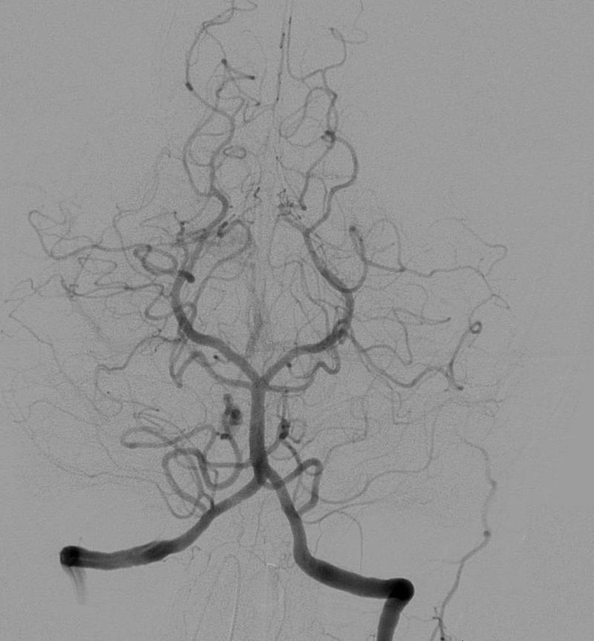
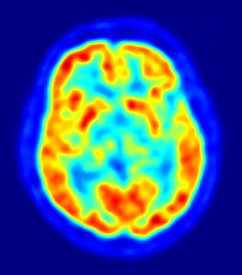
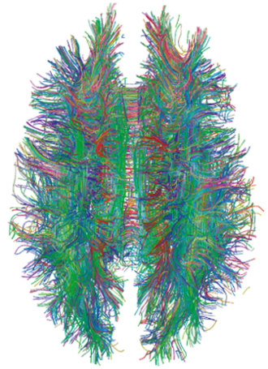
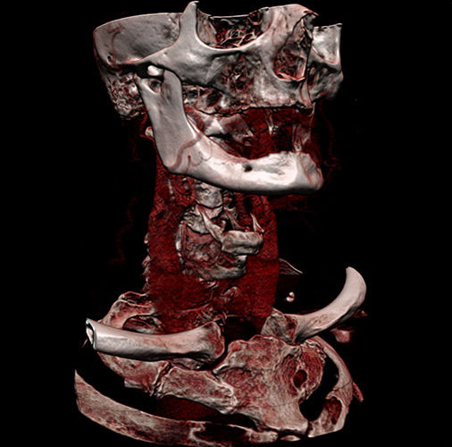
SH2314 Medical Imaging Signals and Systems, Spring 2021
Welcome to
Mats Persson, KTH Dept. of Physics
Radiography
Nuclear Medicine
Computed tomograhy
MRI
Ultrasound
Lipothymia - https://en.wikipedia.org/wiki/Angiography#/media/File:Cerebral_angiography,_arteria_vertebralis_sinister_injection.JPG
Chumpus Rex https://en.wikipedia.org/wiki/CT_scan#/media/File:Ct-workstation-neck.jpg
Arning, Grzyska
Cardiovascular Ultrasound volume 2, Article number: 7 (2004)
Jens Maus https://en.wikipedia.org/wiki/Positron_emission_tomography#/media/File:PET-image.jpg
https://en.wikipedia.org/wiki/Connectome#/media/File:White_Matter_Connections_Obtained_with_MRI_Tractography.png
Notes:
Greetings! My name is Mats Persson and I am an assistant professor here at KTH department of physics. It is my great honor to welcome you to the course SH2314 Medical imaging signals and systems.
This year has been a special year for everybody. Due to the Corona restrictions, we will not be able to give the class in person this year, but it will be given over zoom, including the exam, and probably the lab as well. I realize that you are fed up with online classes at this point. But these isnot much we can do right now about that. What I can do is to do my best to make sure that we use the available opportunities to make the best out of the situation. And by working together with some creativity I hope that we can all accomplish a class that is informative for all of you and that is fun to take and makes the best out of the resources that we have for this online teaching format. By working together we will understand the underlying principles and engineering implementations of radiography, of computed tomography, of nuclear medicine, of ultrasound and MRI.
I am looking forward to giving this class to you all, and I am looking forward to seeing you all in the first lecture!

